Slide 1
Thread locating and tracking Problem
Khurshid Shaymardanov
Data Science
General Assembly

Slide 2
Project Outline
Main Project Idea: Thread Location with regards to Datum
The Main Idea
Business Problem and Real World Impact
Stakeholders (Human & Otherwise)
Data Collection
Current Work Status

Slide 3
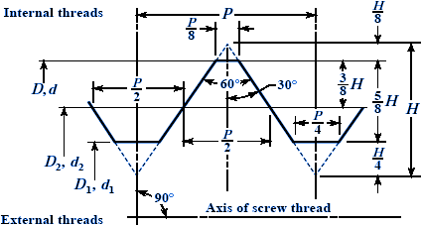
The Main Idea
3 of 11
The object of this work is to develop a robust automatic method for measuring a thread location as current approaches are limited to only do this manually, individually and most of the times not 100% regarding the quantity of those threads on a part;
Additionally, estimate the accuracy for true position (TP) location which includes a lot error to predict
Where and if possible, to collect thread specifications like pitch, thread count, thread type: being left or right and fine or coarse;
Make a solution foundation for this
problem.

Slide 4
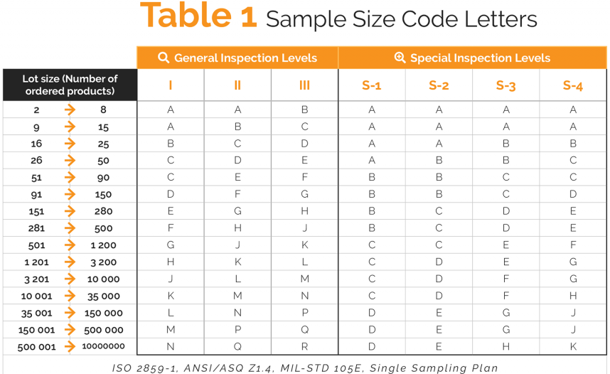
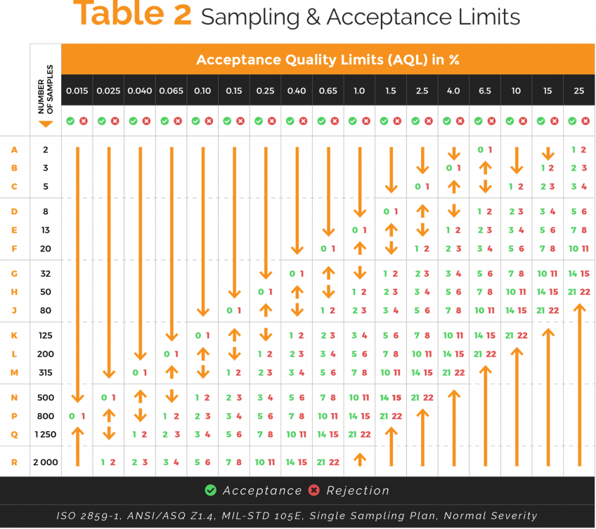
Business Problem
4 of 11
Incoming inspection of product acceptance sampling is based on AQL (acceptable quality limit): The lot of 200 parts will be rejected if found only 1 non-conforming part. The part with $500/pc price is made 400 pcs/day!
This is only 1 part taken as an example out of thousands, millions…

Slide 5
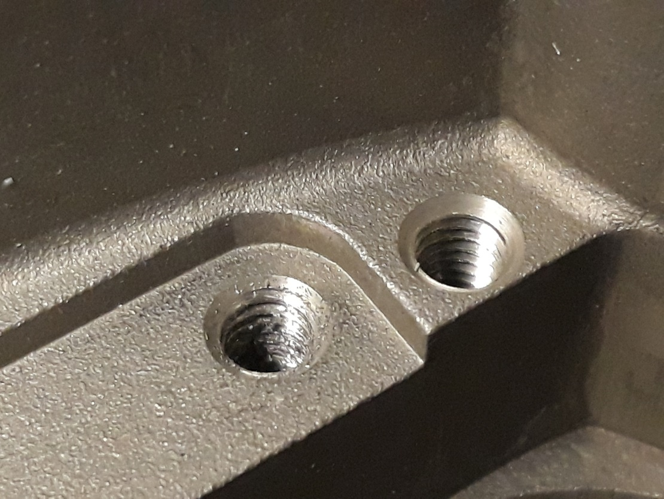
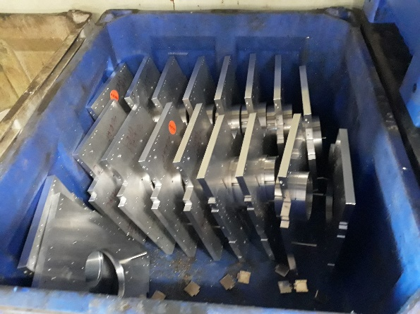
Business Problem (cont-d.)
Thread (bolt, nut, screw) is one of the features to have difficulty in
measuring the coordinate or relative location against 3 axes or Datum.
This is in part due to inaccuracy of thread manufacturing process.
Because of improper/incomplete mating male (or bolt) and female (or nut) threads, parts are rejected by the customer leading to the lot rejection hence sorting with really slow (w thread gage) and way faster (w CMM) methods.
Almost every 10th part have threads with a big probability of being rejected.
There is no any method on correct screening process with CMM thus leading to good parts to be rejected or bad parts to be accepted in manufacturing.
Implementation of such a practice, would save these plus more:
Eventually, this would be a breakthrough for QA/QC field.

Slide 6

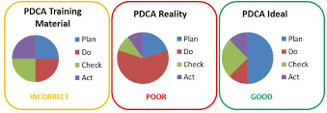
Stakeholders: Suppliers & Customers
Business success in manufacturing depends on the customer satisfaction, but with no clear confidence on the part quality, we can’t take chances.
During the business plan elaboration, we assume that we won’t make bad products, but it is unavoidable sometimes. Those times may be the reason for discontinuation of that given part loosing a lot of jobs, employees, time and financial losses as well.
Preliminary studies have showed already that many customers’ satisfaction level is getting better with current state of the findings but it still needs to have clear model or methodology to focus on specifics of the production process for different product lines along with its own improvement thanks to Data Science.

Slide 7
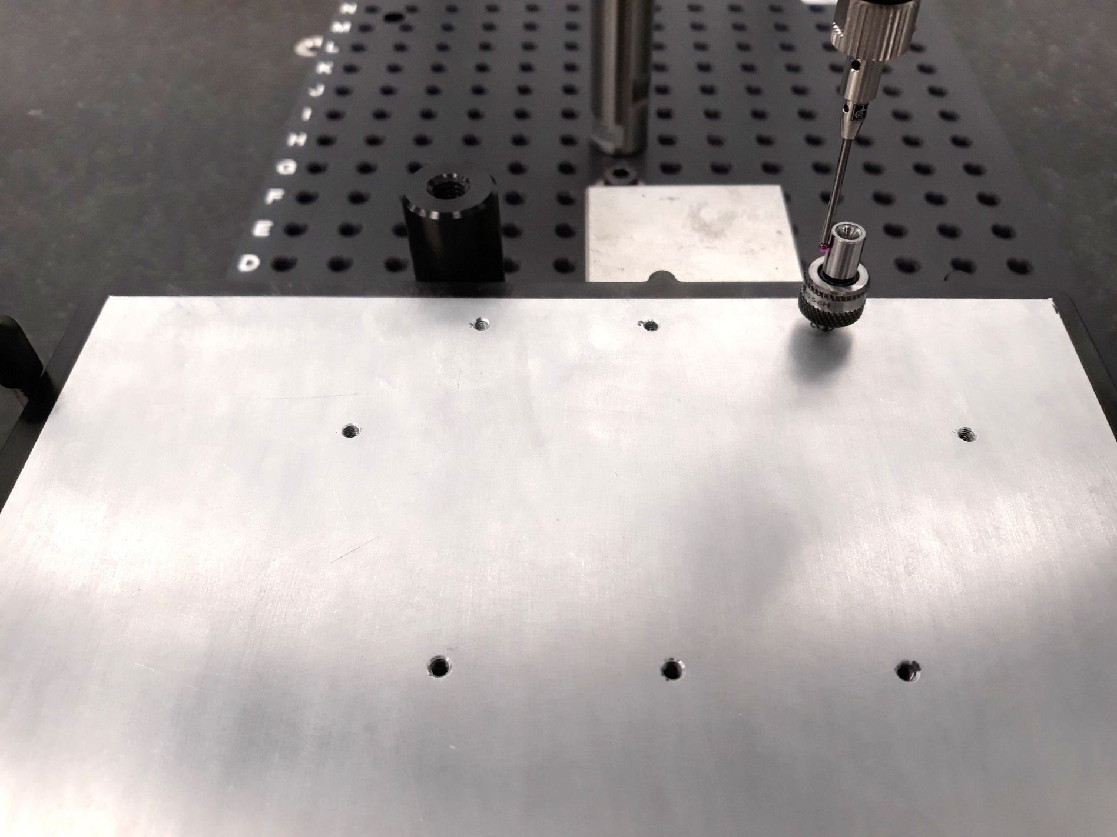
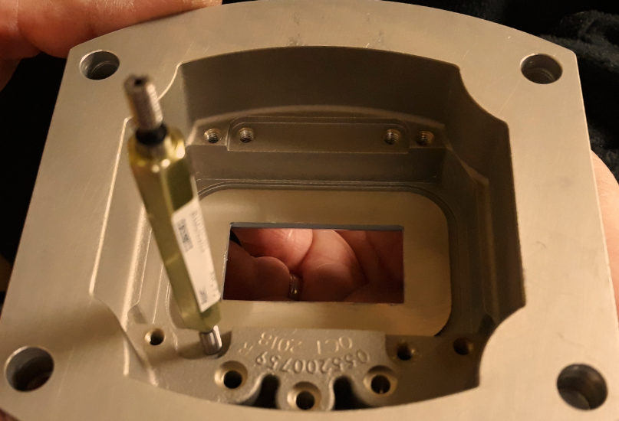
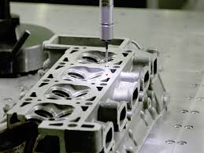
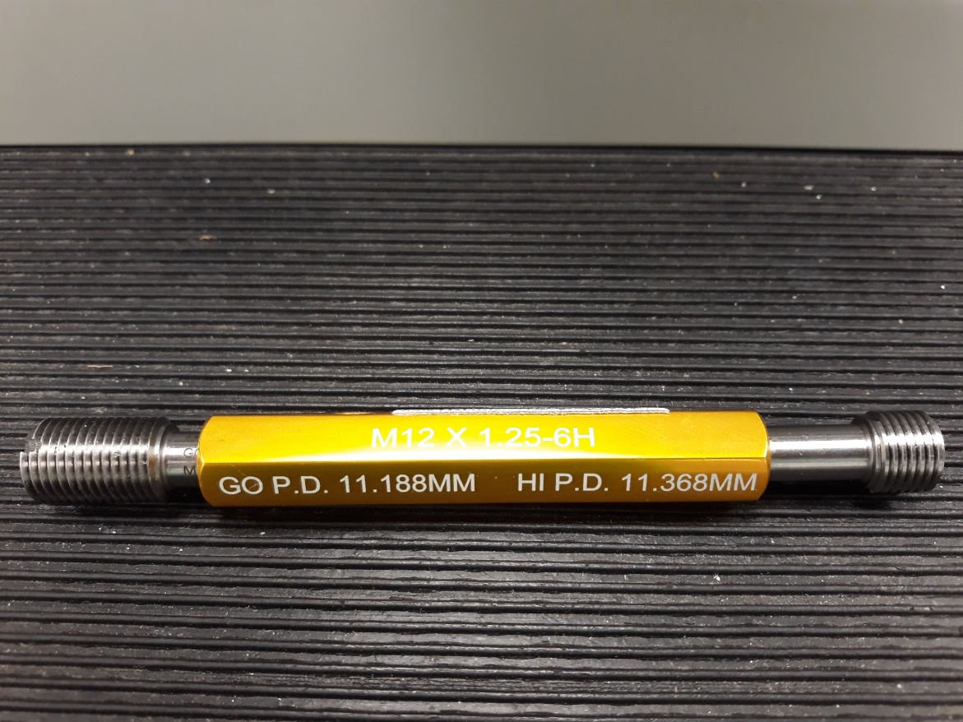
Data Collection - Design of Experiment, DOE-1
7 of 11
Before starting the work, room condition is checked: temperature and humidity
Coordinate measuring machine (CMM) is the main tool;
1, 1.5 & 2 mm sphere tips are used for CMM
Thread locator is the reference to verify the error.
Input data for samples:#4-40 inch and M3x0.5 metric internal threads;
1 thread is measured several times in 2 approaches making from720 to 0 angles:
Touch trigger probe: 7, 10 & 20 pnts per pitch clock- and counter-clockwise
Scanning probe speed: 7, 10, & 20 pnts/mm (density) per pitch clock- and counter-clockwise
Scan acceleration: 11.099 mm/s2, offset force: 0.076 N;
Tolerance: Size-0.100 mm, Location -0.100 mm, Form-0.100 mm.
Filters: Outlier- 3Sigma, filter-Gausian, UPR-50;
Go side
No Go side

Slide 8
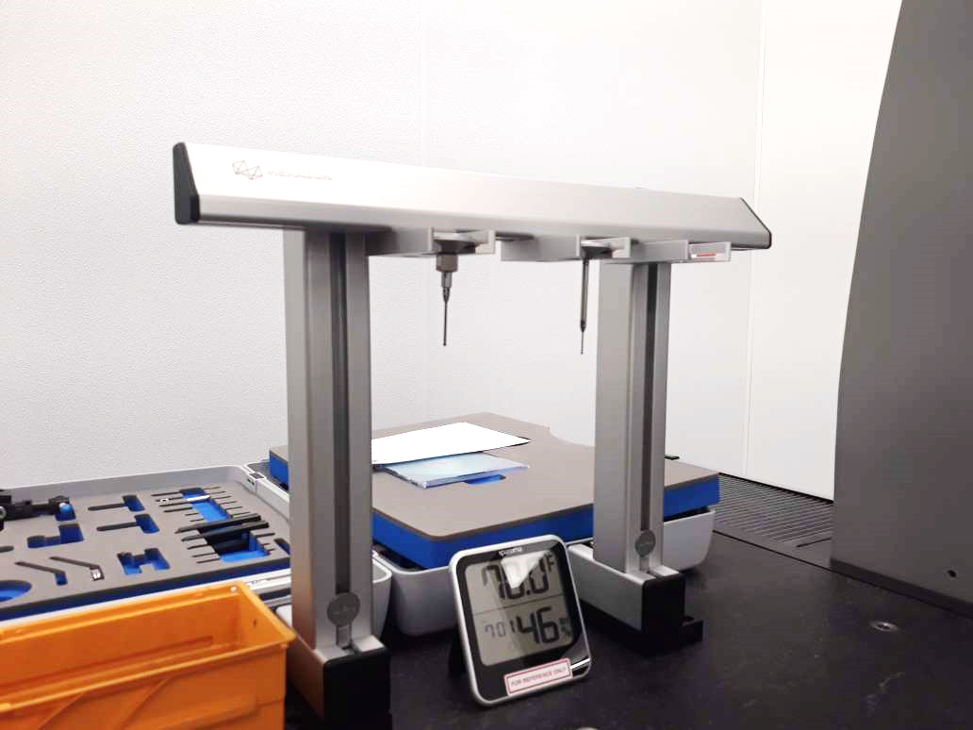
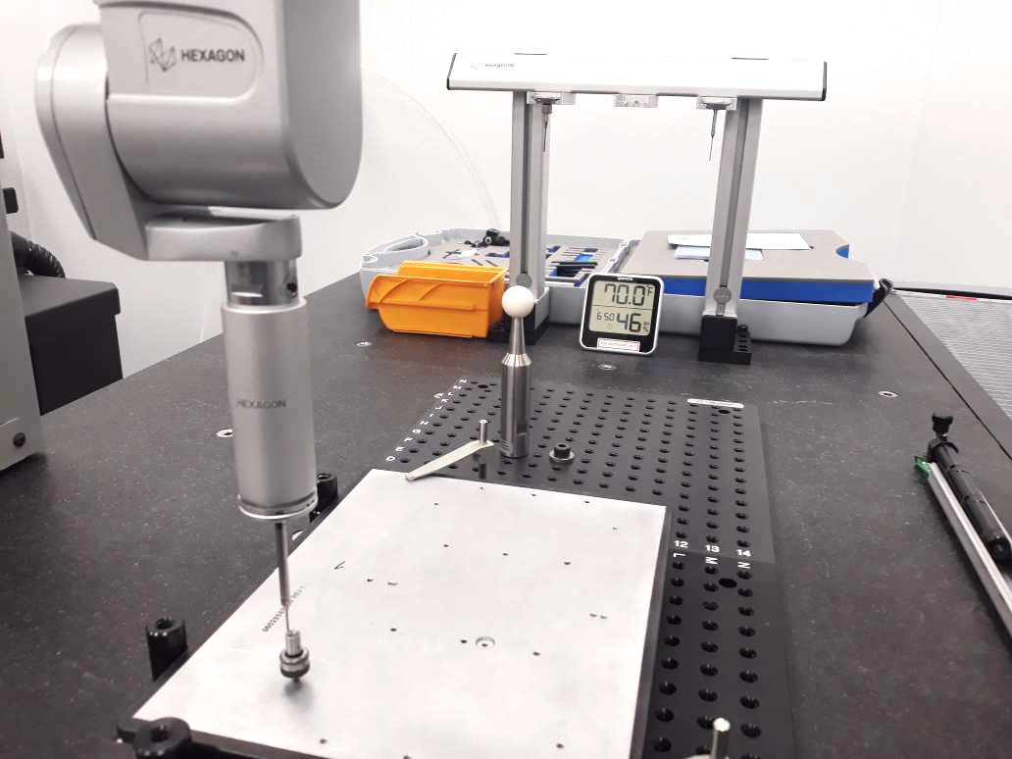
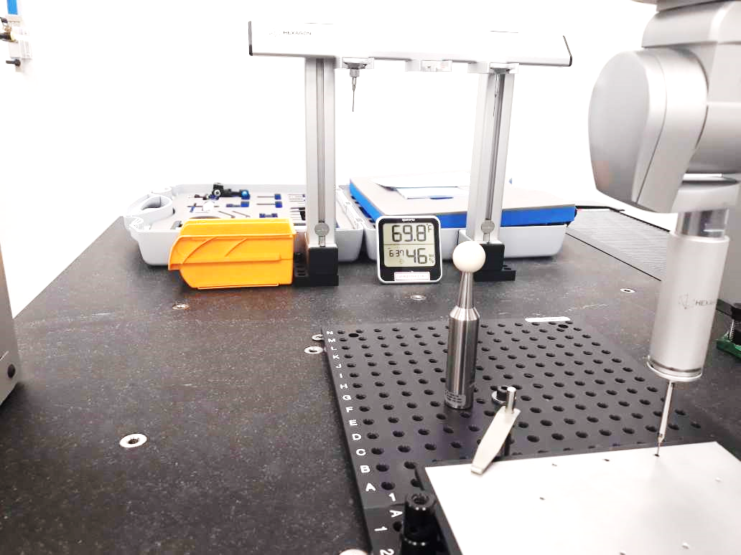
DOE 2:
8 of 11
Tips:
2mm, 1.5 mm(w short ext.), 1.5 mm (w long ext.)
Touch Trigger
No. of pnts/feat (qty)
Scanning
No. of pnts/mm (dty)
Thread Locator (TL):
No. of pnts/feat (qty)
2mm
1.5mm
35mm ext.
TL
Clockwise:
From: 720º or 360º
To: 0 or -360 º
Counter-Clockwise:
From: 720º or 360º
To: 0 or -360 º
Clockwise:
From: 720º or 360º
To: 0 or -360 º
Counter-Clockwise:
From: 720º or 360º
To: 0 or -360 º
Clockwise:
From: 720º or 360º
To: 0 or -360 º
Pnts dty: 7
Pnts dty: 10
Pnts qty: 7
Pnts qty: 10
Pnts qty: 20
Pnts qty: 50
Pnts qty: 100
Pnts qty: 7
Pnts qty: 10
Pnts qty: 20
Pnts qty: 50
Pnts qty: 100
Pnts dty: 7
Pnts dty: 10
Pnts dty: 20
Pnts dty: 50
Pnts dty: 100
Pnts dty: 7
Pnts dty: 10
Pnts dty: 20
Pnts dty: 50
Pnts dty: 100
Pnts qty: 8
1.5mm
20 mm ext.
Total points collected:
Case 1: 2.0 mm by 30 mm tip & 5 mm extention – 6108 pnts
Case 2: 1.5 mm by 20 mm tip & 35 mm extention – 10003 pnts
Case 3: 1.5 mm by 30 mm tip & 20 mm extention – 9999 pnts

Slide 9
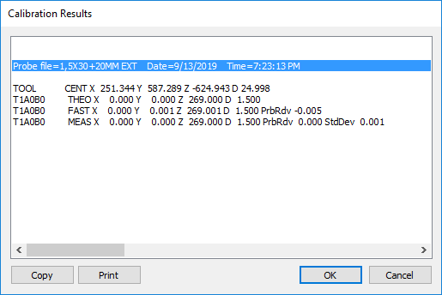
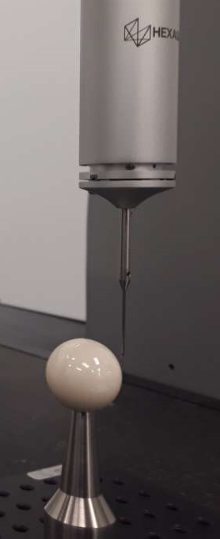
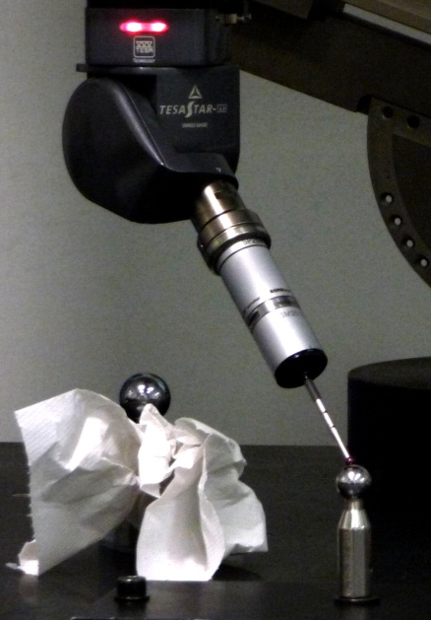
Tip Calibration
9 of 11
Probe file=2X30MM+EXT Date=9/23/2019 Time=11:05:15 AM
TOOL CENT X 171.629 Y 487.328 Z -625.417 D 24.998
T1A0B0 THEO X 0.000 Y 0.000 Z 266.000 D 2.000
T1A0B0 FAST X 0.000 Y 0.000 Z 265.998 D 2.000 PrbRdv -0.005
T1A0B0 MEAS X 0.000 Y 0.000 Z 266.000 D 2.000 PrbRdv 0.000 StdDev 0.000
Probe file=1BY20+35EXT Date=9/23/2019 Time=9:25:17 AM
TOOL CENT X 171.465 Y 487.376 Z -625.480 D 24.998
T1A0B0 THEO X 0.000 Y 0.000 Z 274.000 D 1.500
T1A0B0 FAST X 0.000 Y 0.000 Z 273.998 D 1.500 PrbRdv -0.004
T1A0B0 MEAS X 0.000 Y 0.000 Z 274.000 D 1.500 PrbRdv 0.000 StdDev 0.000
Probe file=1,5X30+20MM EXT Date=9/20/2019 Time=4:36:40 PM
TOOL CENT X 171.399 Y 487.343 Z -625.593 D 24.998
T1A0B0 THEO X 0.000 Y 0.000 Z 269.000 D 1.500
T1A0B0 FAST X 0.000 Y 0.000 Z 268.999 D 1.500 PrbRdv -0.007
T1A0B0 MEAS X 0.000 Y 0.000 Z 269.000 D 1.500 PrbRdv 0.001 StdDev 0.001

Slide 10
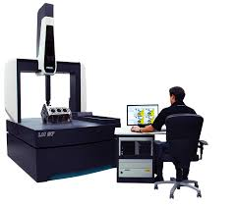
CMM Accuracy
10 of 11

Slide 11
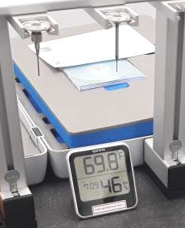
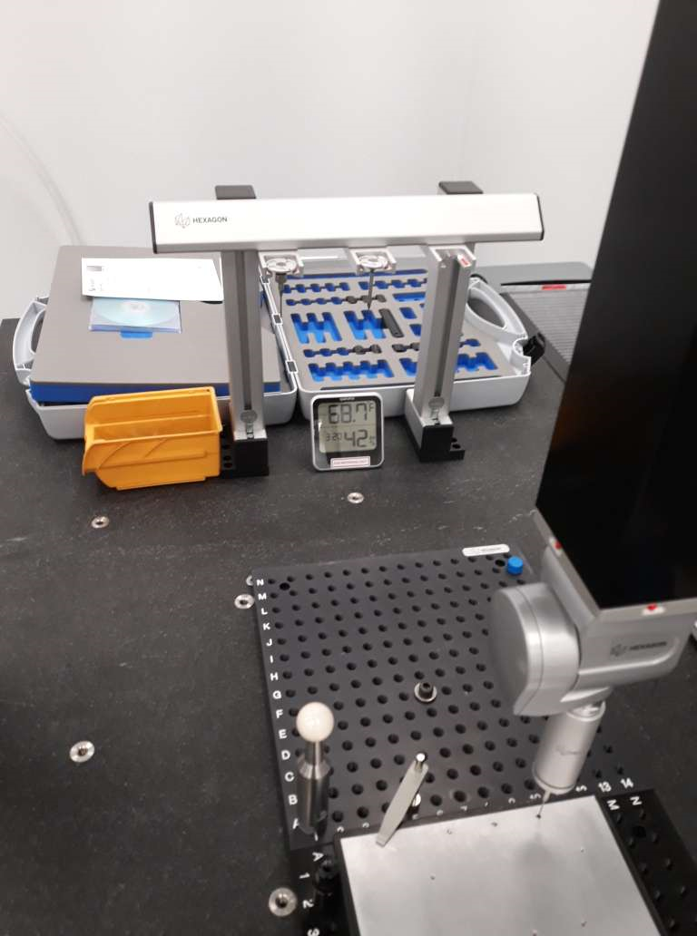
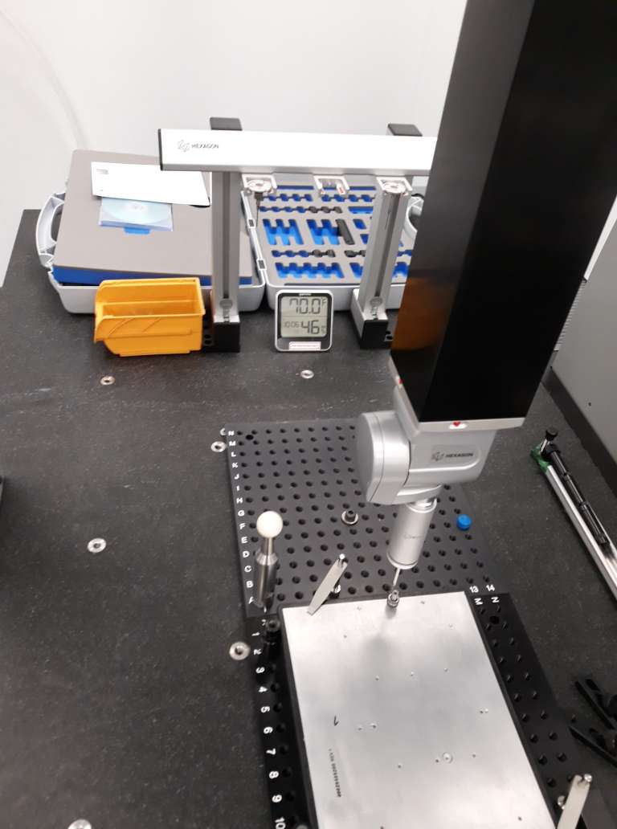
Room temperature and humidity
11 of 11
Room Condition during initial tests:
9/13/2019, 6.37 pm: 69.8 F, 46 RH%
9/13/2019, 6.50 pm: 70.0 F, 46 RH%
9/13/2019, 7.01 pm: 70.0 F, 46 RH%
9/13/2019, 7.09 pm: 69.8 F, 46 RH%
9/20/2019, 3.20 pm: 68.7 F, 42 RH%
Room Condition during final tests:
9/23/2019, 10.06 am: 70.0 F, 46 RH%
9/23/2019, 11.22 am: 70.0 F, 45 RH%
Let’s Go to the Data Analysis part of the project

